Slide 1
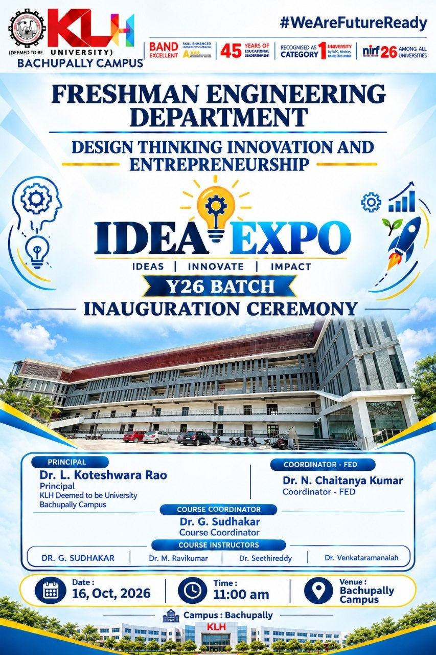
Major Project Presentation
Smart Classroom & AI Timetable Generator
An end-to-end intelligent platform that automates conflict-free schedule generation while controlling classroom noise, door access, and live campus updates in real time.
PROJECT LEAD & PRESENTERS
Manikanta ,Vignesh & Ram Charan

Slide 2


01 / PROBLEM IDENTIFICATION
Existing Challenges in Campus Management
Manual Scheduling Bottlenecks
Drafting timetables manually takes weeks of administrative effort, frequently causing human calculation errors, faculty timing clashes, and unorganized course schedules.
Room Overlaps & Overcrowding
Uncoordinated bookings result in two classes assigned to one room, overcrowded lecture halls, and sudden room reassignments that confuse students and staff.
Hallway Disturbances & Noise
Excessive hallway chatter, unmonitored noise, and unauthorized walk-ins disrupt active lectures, degrading student focus and class quality.

Slide 3



02 / EMPATHY & USER RESEARCH
Key Stakeholder Pain Points
Faculty Members
Students
Administration
Main Struggle: Managing conflicting class times and last-minute room swaps.
Main Struggle: Unclear schedule changes and noisy learning environments.
Main Struggle: Labor-intensive manual coordination across departments.
•
Loss of lecture time re-verifying room allocations.
•
Tedious spreadsheet processing for hundreds of courses.
•
Confusion from outdated paper timetables on notice boards.
•
Frustration from back-to-back classes in distant blocks.
•
Difficulty tracking room capacity utilization efficiently.
•
Distractions caused by hallway noise during continuous lectures.
•
Lack of automatic rest period enforcement in schedules.
•
High administrative overhead when handling leave requests.
•
Unplanned walk-ins interrupting focused study sessions.

Slide 4

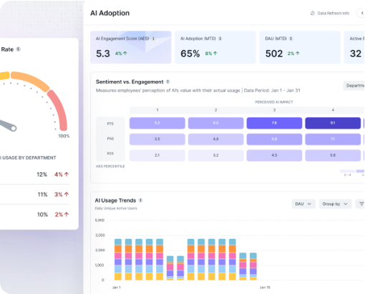
03 / SYSTEM VISION
Core System Architecture & Objectives
Primary Objective
Deliver a 100% Conflict-Free Smart Campus Ecosystem
1. Algorithmic Scheduling Engine
Automatically evaluates faculty workloads, lab equipment needs, and room capacities to generate optimal timetables within seconds.
2. Automated Environmental Control
Monitors hallway noise levels, triggers automated door locks during ongoing lectures, and dims lights in empty classrooms to save power.
3. Real-Time Campus Synchronization
Instantly syncs schedule updates to student mobile apps, faculty web dashboards, and digital room displays outside every classroom.

Slide 5
04 / BRAINSTORMING & INNOVATION
Four Core Innovation Pillars
1. AI Schedule Generator
2. Teacher Rules Engine
Uses constraint-satisfaction algorithms to test thousands of time slot combinations, eliminating double-bookings and room conflicts.
Configures maximum daily workloads, preferred working hours, subject expertise, and mandatory rest intervals for every faculty member.
3. Smart Room Matcher
4. IoT Hardware Hub
Pairs classes with rooms according to student capacity, projector availability, specialized lab requirements, and campus location.
Integrates smart door access locks, decibel noise sensors, and digital doorway displays connected to a central control unit.

Slide 6
05 / FEATURE SELECTION
Prioritized Feature Implementation Stack
RANK 1
AI Schedule Generator (Core Engine)
Highest impact feature. Automatically resolves overlapping teacher assignments, subject constraints, and classroom capacities.
Smart Door Locks & Sound Level Sensors
RANK 2
Essential hardware layer. Restricts unauthorized entrance during active class sessions and alerts students when hallway noise exceeds acceptable levels.
RANK 3
Student Mobile App & Digital Door Displays
Provides real-time schedule visibility across campus, pushing push notifications whenever a room change or faculty update occurs.
Automated Energy Management
RANK 4
Secondary optimization feature. Cuts electricity waste by turning off HVAC and lighting systems automatically when classrooms are unoccupied.

Slide 7
06 / SYSTEM ARCHITECTURE
Unified Smart Campus Execution Flow
STEP 01
STEP 02
STEP 03
Data Ingestion Phase
AI Engine Processing
Live Campus Sync
Administrators upload essential campus data via the central web portal:
The AI scheduling algorithm evaluates complex multi-variable rules:
Finalized timetables are pushed instantly across all connected systems:
•
Faculty availability & course lists.
•
Eliminates double-booked professors.
•
Digital e-ink displays outside classrooms.
•
Room capacities & lab equipment.
•
Prevents room capacity overflow.
•
Student mobile app timelines.
•
Student batch sizes & time preferences.
•
Generates clash-free schedules in seconds.
•
IoT smart door access relays.

Slide 8

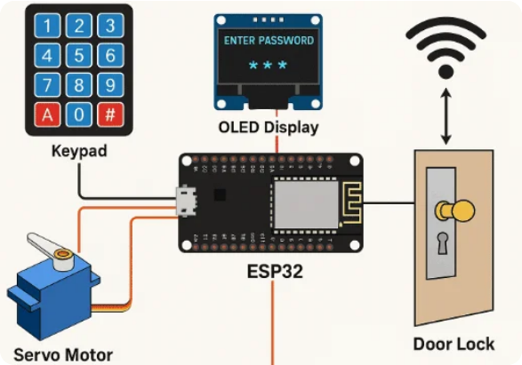
07 / PROTOTYPE DESIGN
Software Dashboard & IoT Hardware Prototype
Central Administrator Web Dashboard
Allows administrators to upload CSV rosters, configure scheduling constraints, run the AI generator, and monitor real-time room occupancy across campus.
Student & Faculty Mobile Interface
Provides students and teachers with personalized daily schedules, real-time push notifications for room swaps, and live class attendance updates.
Classroom Door IoT Display Module
Mounted outside each lecture hall. Shows the current ongoing lecture, next scheduled session, live noise alerts, and controls RFID door access.

Slide 9
08 / OPERATIONAL DEMONSTRATION
Step-by-Step Live Workflow Walkthrough
1
2
3
4
Upload Data
Run AI Engine
Deploy IoT Sync
Live System Check
Load faculty working hours, course requirements, student numbers, and room capacity limits into the central cloud database.
Execute constraint optimization rules to generate master timetables without timing overlaps or room double-bookings.
Broadcast generated schedules to digital hallway displays, activate smart door lock timers, and sync student mobile apps.
System auto-locks classroom doors during active lectures, triggers visual noise alerts in corridors, and dims lights in empty rooms.

Slide 10
Summary & Q&A Session
Thank You!
Smart Classroom & AI Timetable Generator provides an efficient, automated, and disruption-free learning environment for modern educational institutions.
Designed & Presented by Manikanta, Vignesh & Ram Charan

